Slide 1
Mountain Medical team Team Leader Training

Slide 2
Introductions

Slide 3
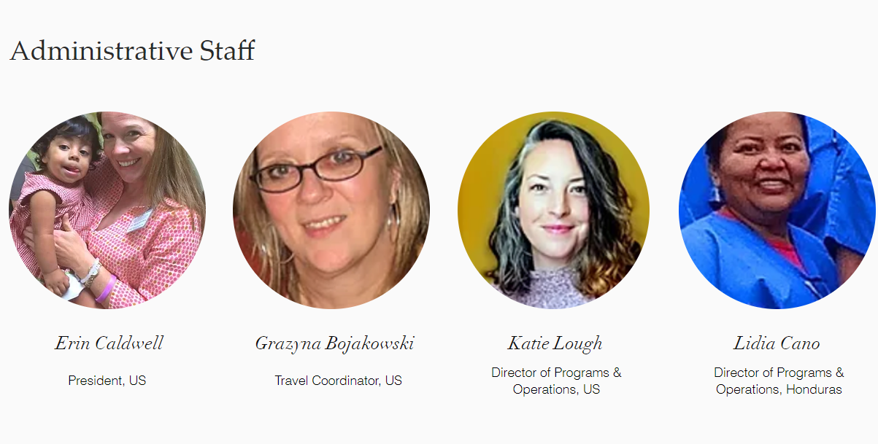
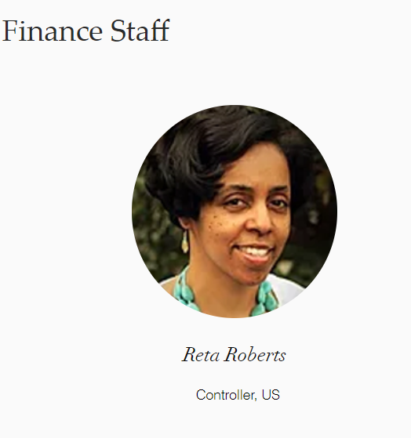
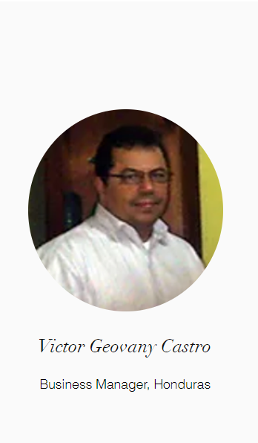
Meet the Friends of Barnabas Staff

Slide 4
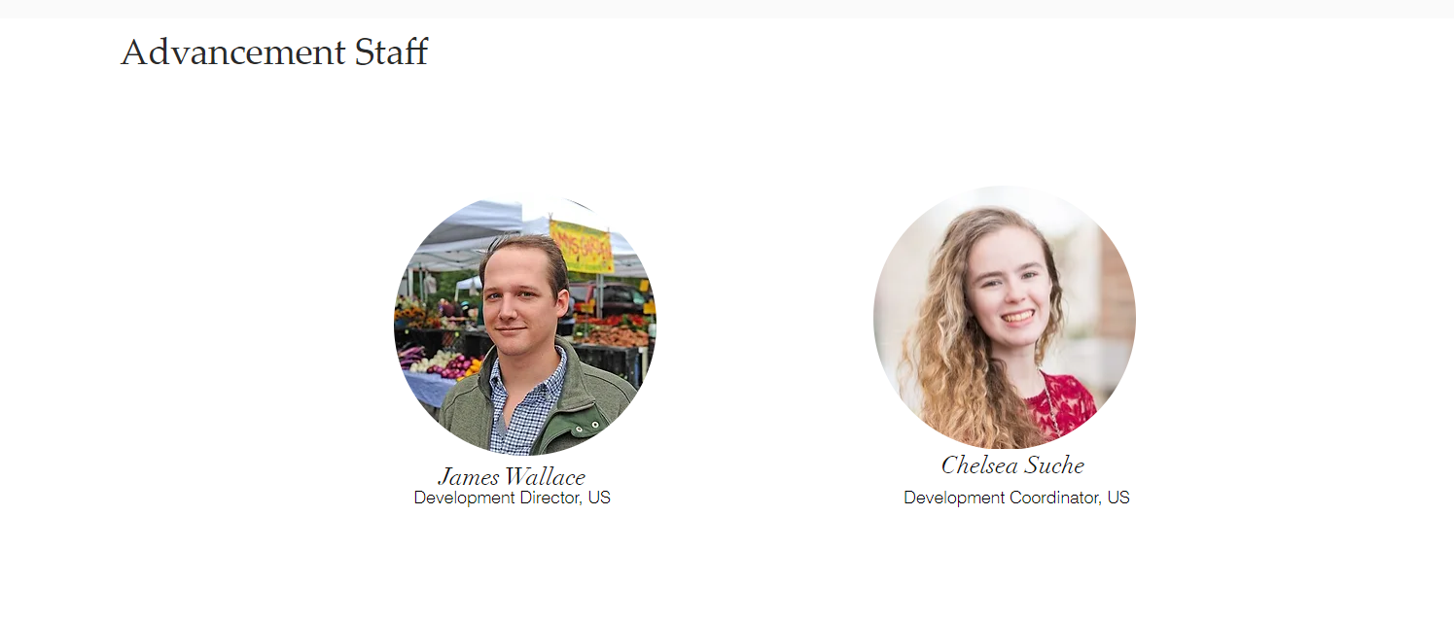
Meet the Friends of Barnabas Staff

Slide 5
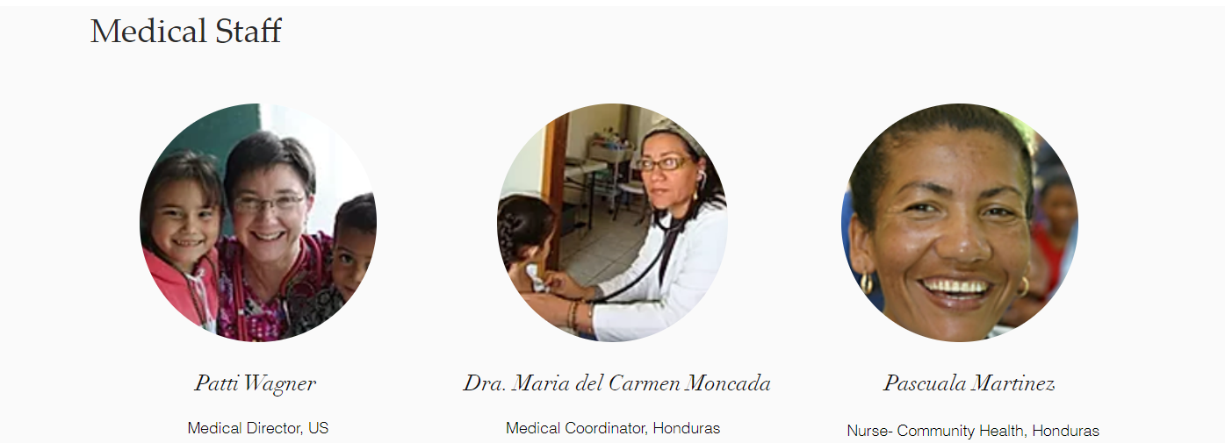
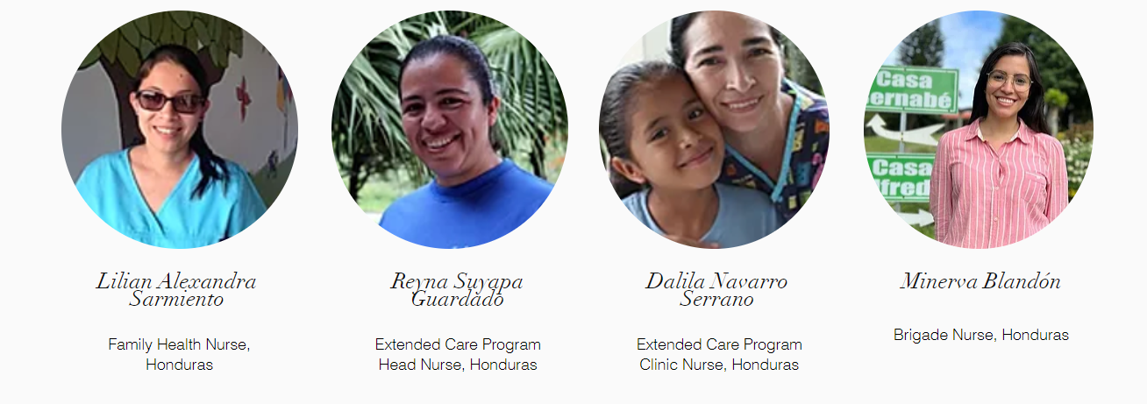

Slide 6
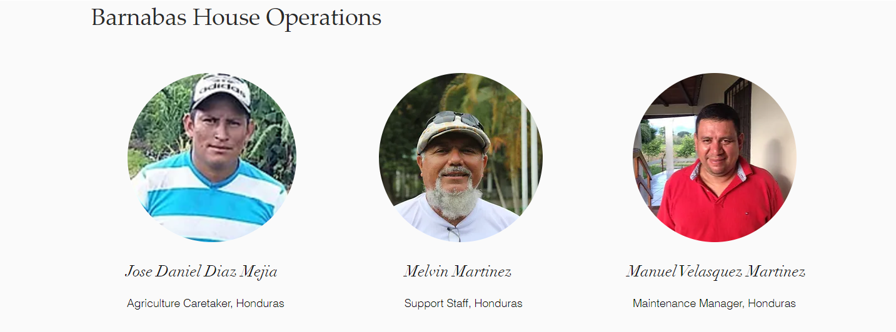
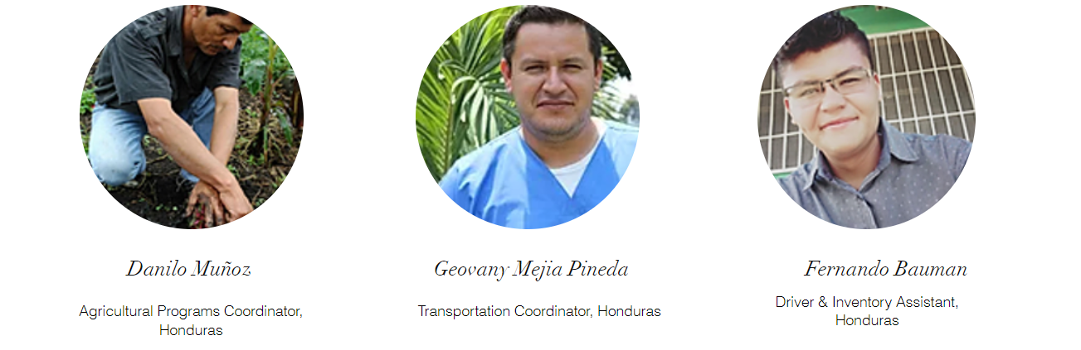
Meet the Friends of Barnabas Staff

Slide 7
Meet the Friends of Barnabas Staff

Slide 8
Pop Quiz!

Slide 9
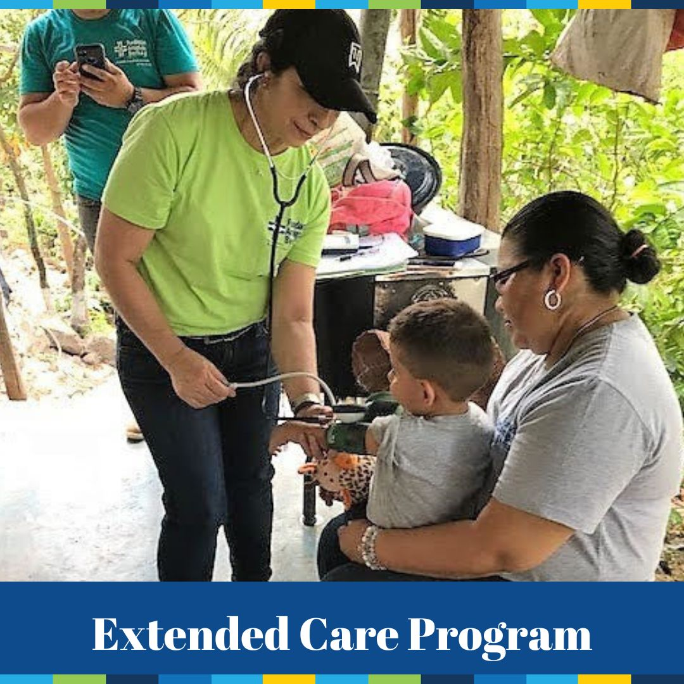
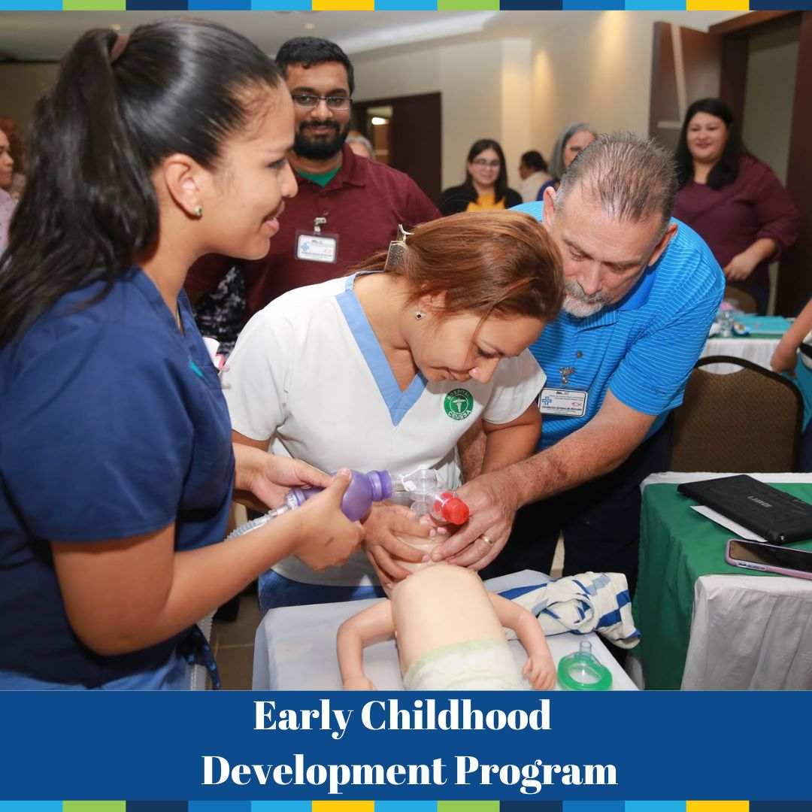
Heal. EDUCATE. Empower. Friends of Barnabas’ mission is to empower families in Honduras through healthcare and education. We envision a strengthened Honduran healthcare system, where all have access to quality care.
FOB’s 3 Program Areas:
Mountain Medical Teams (MMTs)
Advanced Learning Communities
First Aid Training Program
We provide medications, case management, education and food staples to 200+ children with special needs.
Training for NICU healthcare workers in Honduran hospitals
Developmental Screenings for children in our communities

Slide 10
Team Leader Responsibilities
Build the team
Prepare the team
Fundraising
On-the-ground leadership

Slide 11
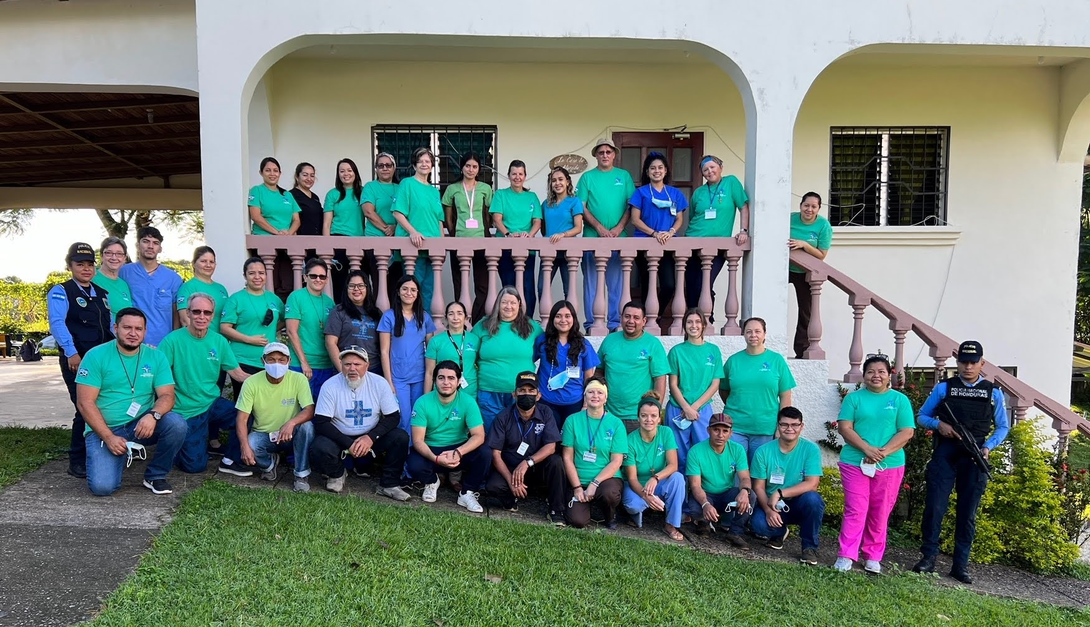
Building Your Team
14 Team Members (10 minimum):
4-6 Medical Volunteers
6-8 Non-medical Volunteers
1-2 Translators
1 in Weights & Measures
2 in Vitamins & De-worming
1 in Pharmacy
2 in Dental
*17-year-old age requirement
Share your recruitment challenges or suggestions.
***Send Informational Email (provided by Katie) to team member as soon as they confirm their participation.***

Slide 12
Preparing Your Team
Informational Email
Provided by Katie
Team Meetings
3 Team Meetings: PowerPoint presentations on the website’s team leader page
1 Medical Meeting with Patti
WhatsApp Group Chat
Team Members will join the Team’s group Chat
Send to team members as soon as they join the team.
Online Registration
Mighty Cause Information
Payment Deadlines
Information on the Website
Fobf.org/mmt
Fobf.org/teamleader
Team Leaders will be in 3 group chats
FOB Team Leaders Chat
Your Team’s Chat
Your Team’s Travel Chat for travel days
No E-learning this year
Add your Team Meeting Dates
Fobf.org/training
Challenges or Suggestions?

Slide 13
Booking Flights
We need departure cities ASAP!
Individual vs Group Ticket
No longer using FTI
We need online registrations to be filled out accurately and on time.
Additional travel insurance is an option that team members can select on their own.

Slide 14
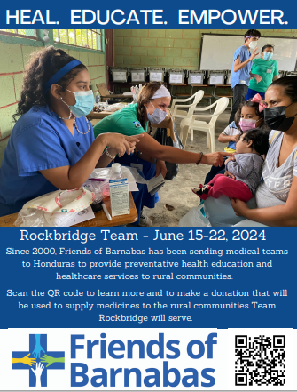
fundraising for Your trip
Individual Team Member Fee: $2250
Covers airfare, ground transportation, accommodations, meals, medical evacuation insurance.
$1000* due the 1st of the month, four months prior to travel (needed to book flight)
$1250* due the 1st of the month, two month prior to travel
*Plus transaction fees for electronic payments.
**Should flights or fuel significantly increase, FOB reserves the right to increase the travel fee.
Team Support Goal: $11,500 due 1st of the month, two months prior to travel
Covers medication and supplies for clinics.
Challenges
or suggestions?
(info@fobf.org)
Jo Ellen’s Letter

Slide 15
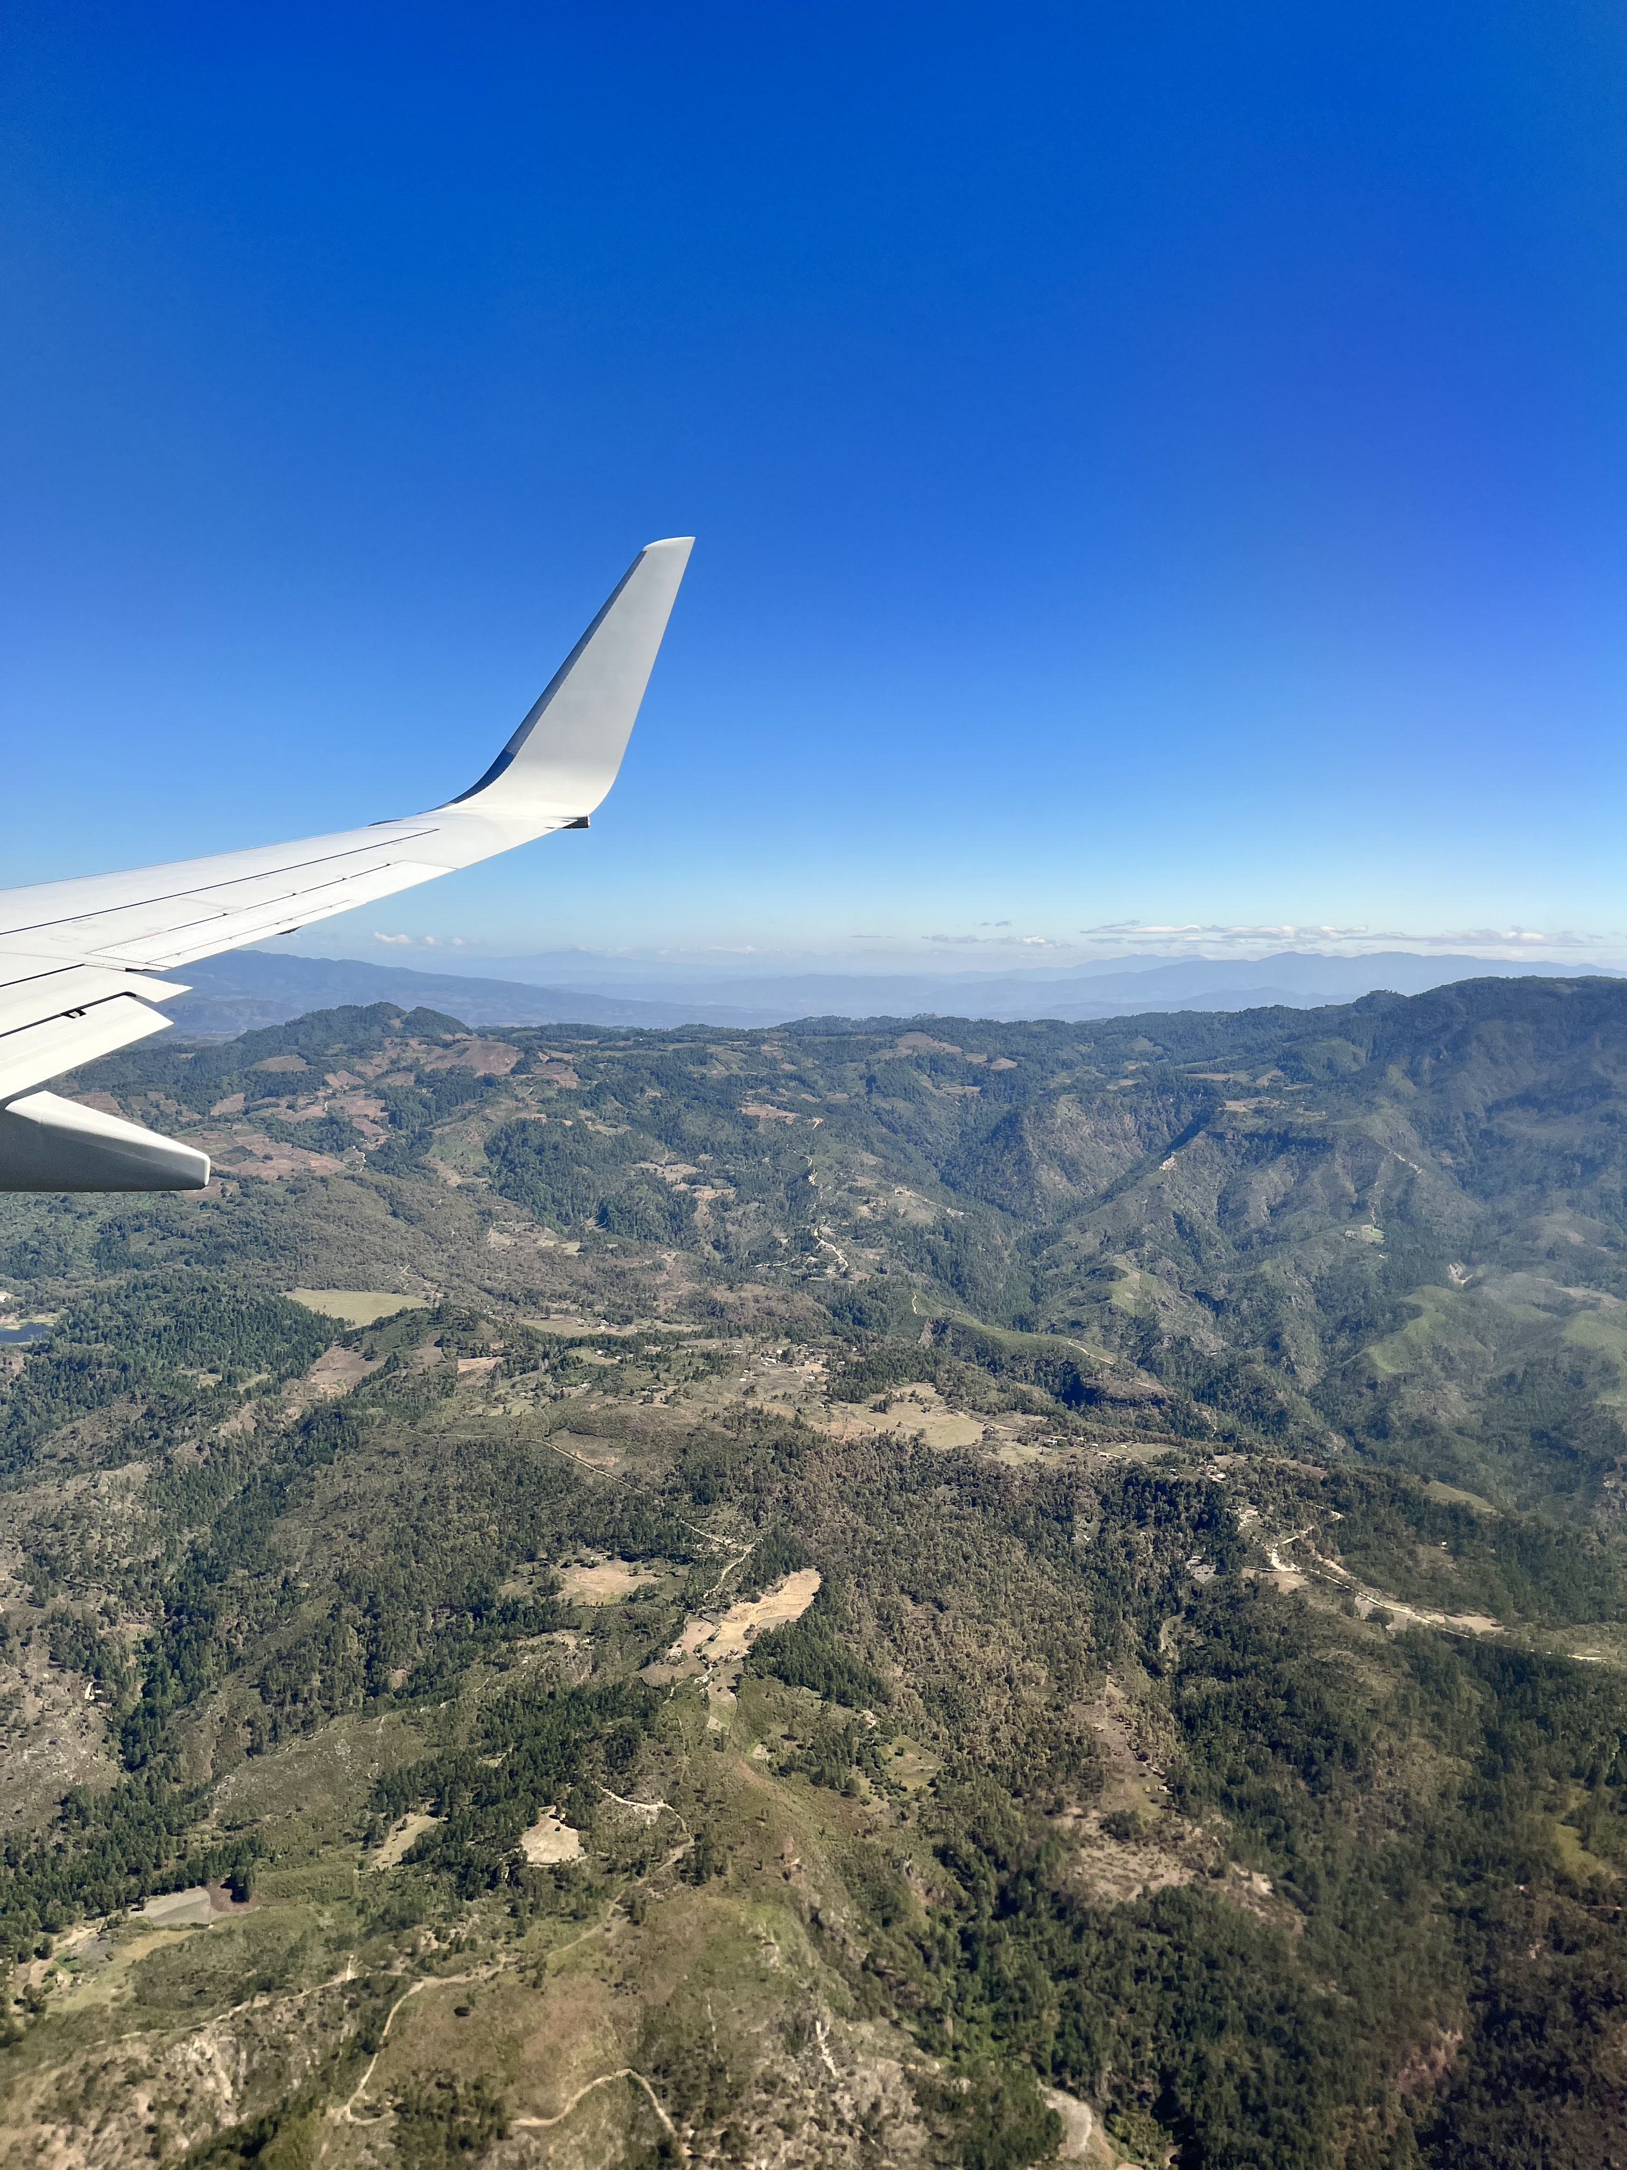
During the Trip Travel Days
Communicate with Staff in WhatsApp Travel Group
If flights are cancelled, don’t rebook without letting Grazyna know. She will be working from her end on getting the team new flights.
Follow instructions given by Katie on getting through customs if your team is bringing medicines or supplies with them.

Slide 16
During the trip Clinic Days
Clinic Days
Communicate plans and times with the team daily (whiteboard)
Debrief each evening
Educate Team on FOB
Saturday tour of Barnabas House
Program overview videos during dinner
Check-in with team members individually on how they are doing.
Answer team members’ questions throughout the week. If you don’t know the answer, ask staff.
Problem Solve with Staff
Flight issues- Grazyna
Everything else- Lidia
Challenges & Suggestions
Team member illness
Team member behavior
Flight issues
EMR issues
Weather issues

Slide 17
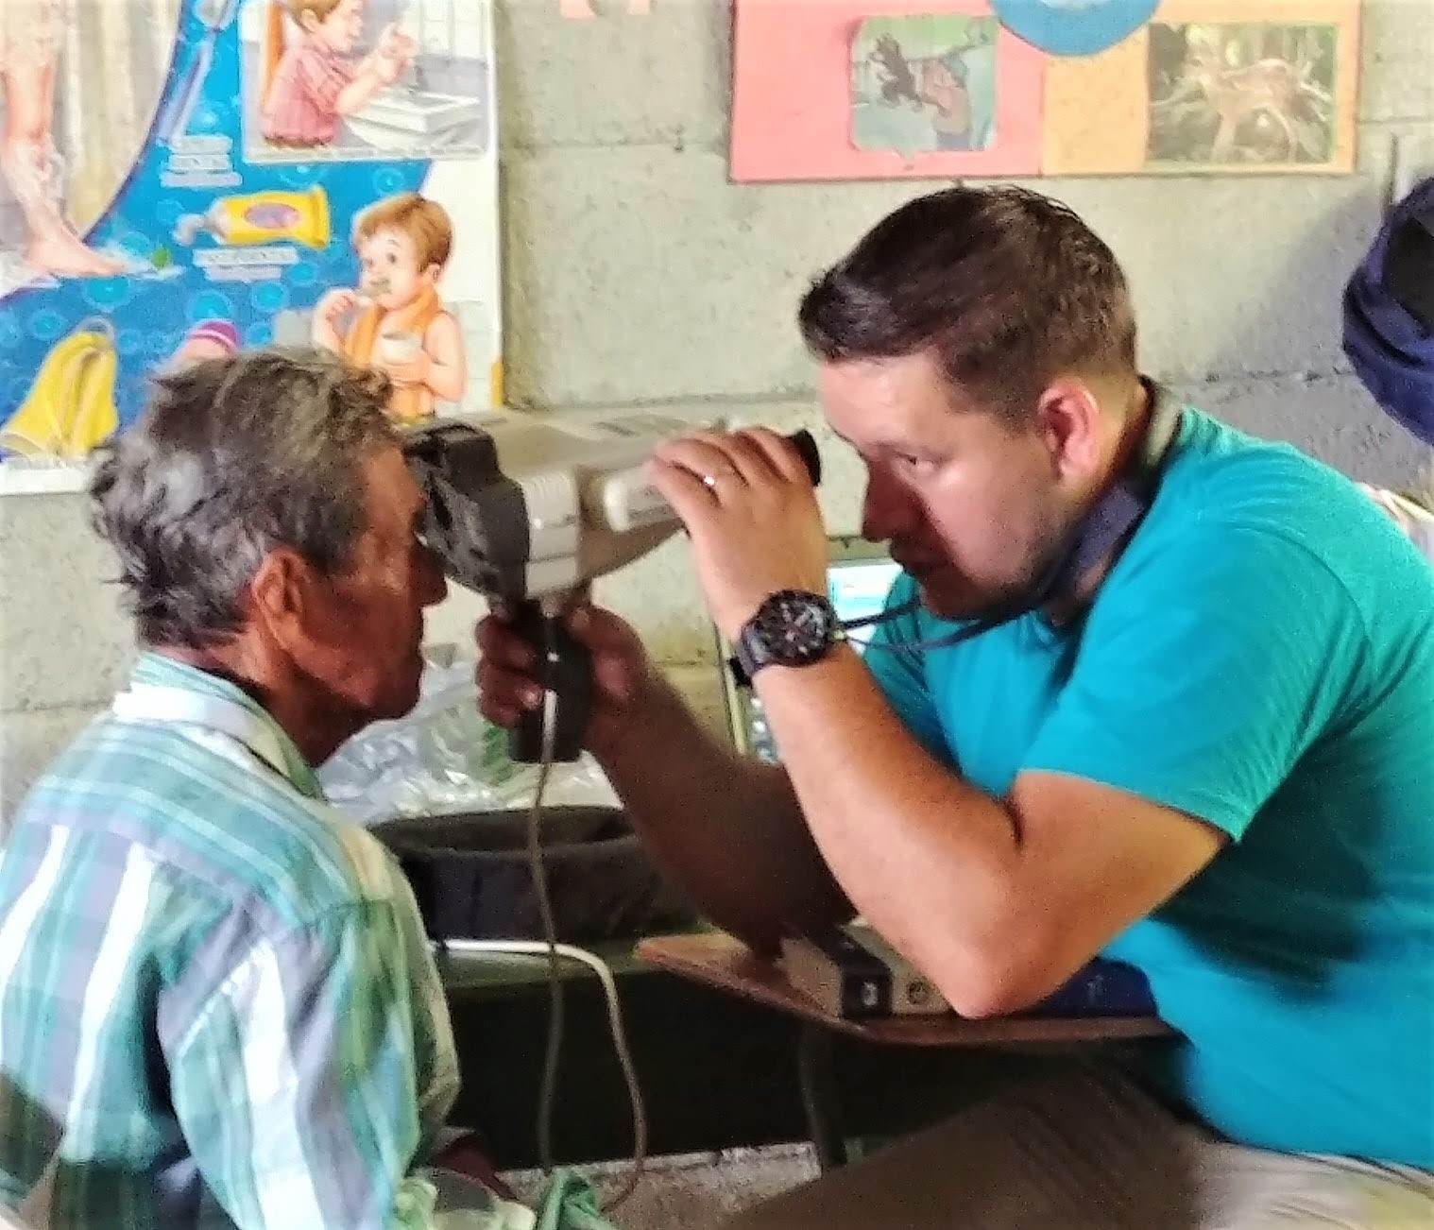
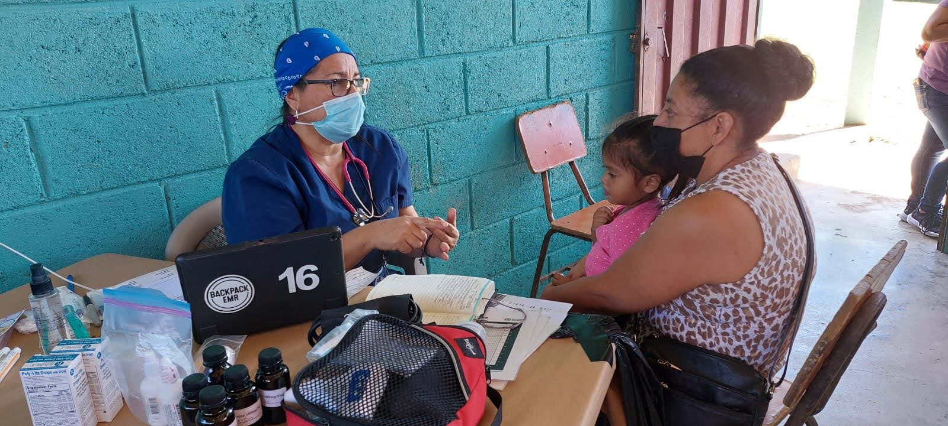
Clinic Updates
New Dental Machine & Documentation
How we are using data collected from the EMR
Changes coming to the Vision Clinic

Slide 18
new for 2024
Team Leader Manual
$1000 travel advance for team (instead of $2000). $1000 worth of lempiras will be given to treasurer upon arrival to Barnabas House without needing to exchange.
Suitcases instead of duffels
No E-learning app. Fobf.org/training
Mighty Cause page – not new in itself, but the new way we are using it.
Team Medicine Box available in Alfredo’s House
NEW FOR 2025 – Changing up Team Names

Slide 19
TIMELINE
12-5 months before trip
Recruit team members & send Informational Email
Start Fundraising
4 months before trip
Online registrations due
$1000 team member deposit due
2 months before trip
$1250 travel balance due
Hold 2nd Team Meeting
Hold 1st Team Meeting
1 month before trip
$11,500 Support funds due
Hold 3rd Team Meeting
Remind team to take at-home covid test
Continue Fundraising
Medical Volunteer Meeting with Patti
1 day before trip
Get team members on WhatsApp Group Chat
Remind team to complete immigration form online
1 week after trip
Return items to Office
1 week before trip
Submit Rooming List to Katie
Coordinate bag(s) with Katie
UMVIM insurance cards to TL’s – no longer sending individual emails to team members.
Collect Medical forms (notarized ) from team members
Get passport copies from Katie
Let us know airport departure cities ASAP
Evaluations
Checklist is in the Team Leader Manual

Slide 20
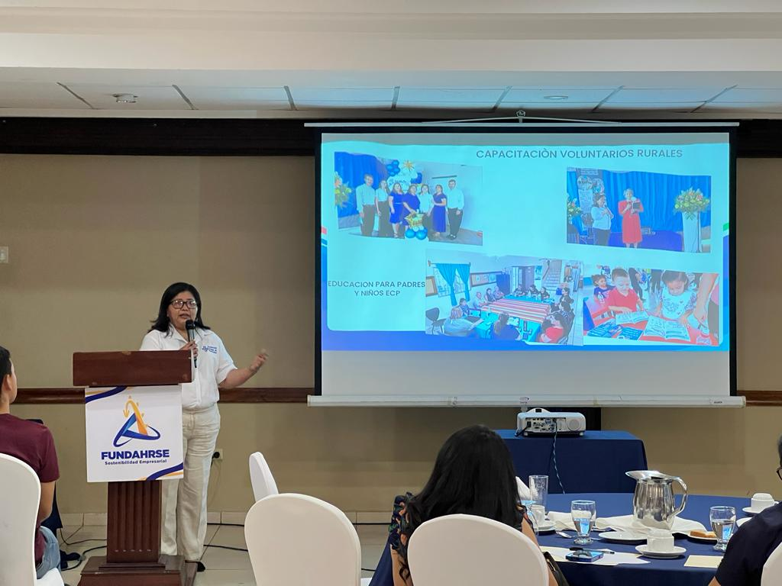
Speaking & Meeting Opportunities

Slide 21
Pop Quiz!

Slide 22
Questions or Comments??

